Slide 1
PRESENTATION ON CTS AND CLS BY SK.SUSHMA

Slide 2
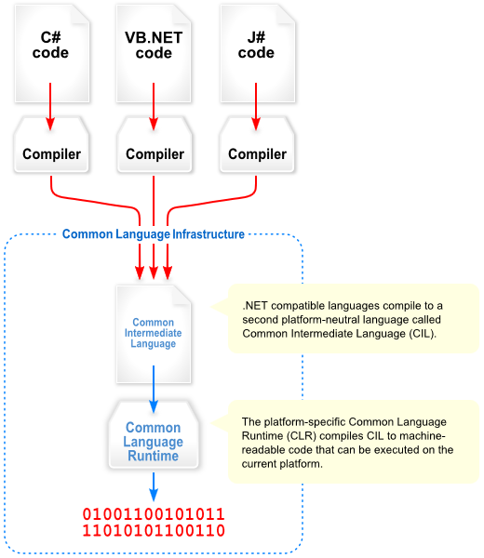

Slide 3
The Common Language Infrastructure
Two components
Common Type System (CTS)
Common Language Specification (CLS)

Slide 4
CTS
It describes set of data types that can be used in different .Net languages in common.
CTS ensures that objects written in different .Net languages can interact with each other.
Two categories of CTS types
Value types
Reference types (an address of a memory location)

Slide 5
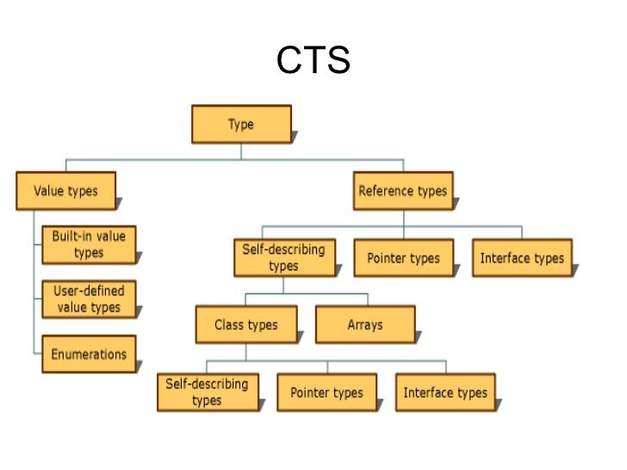

Slide 6
Value types Value types directly contain their data, and instances of value types are either allocated on the stack or allocated inline in a structure. Value types can be built-in (implemented by the runtime), user-defined, or enumerations.

Slide 7
Reference types Reference types store a reference to the value's memory address, and are allocated on the heap. Reference types can be self-describing types, pointer types, or interface types. The type of a reference type can be determined from values of self-describing types. Self-describing types are further split into arrays and class types. The class types are user-defined classes, boxed value types, and delegates.

Slide 8
CLS It is a sub set of CTS and it specifies a set of rules that needs to be adhered or satisfied by all language compilers targeting CLR. It helps in cross language inheritance and cross language debugging.

Slide 9
Common language specification Rules It describes the minimal and complete set of features to produce code that can be hosted by CLR. It ensures that products of compilers will work properly in .NET environment. Sample Rules: 1. Representation of text strings. 2. Internal representation of enumerations. 3. Definition of static members and this is a subset of the CTS which all .NET languages are expected to support. 4. Microsoft has defined CLS which are nothing but guidelines that language to follow so that it can communicate with other .NET languages in a seamless manner.

Slide 10
THANK Q

